Slide 1
Mobile Application Development - Day 5
Dialogs
Custom
Default
Fonts
Form Validation
Utils Class
Text Empty Check
editText.setError(“Msg”)

Slide 2
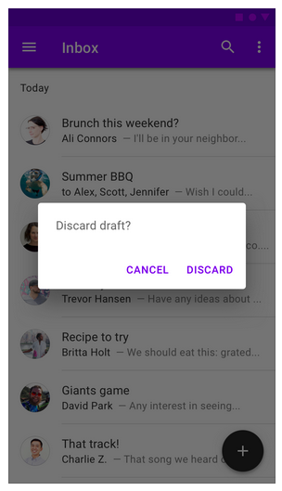
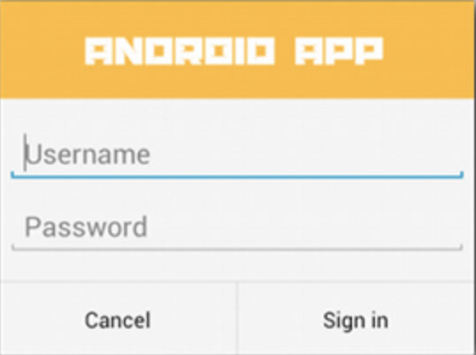
Dialog
A dialog is a small window that prompts the user to make a decision or enter additional information.
A dialog does not fill the screen
Used for modal events that require users to take an action before they can proceed.
The Dialog class is the base class for dialogs, but you should avoid instantiating Dialog directly. Instead, use one of the following subclasses: AlertDialog
A dialog that can show a title, up to three buttons, a list of selectable items, or a custom layout.

Slide 3
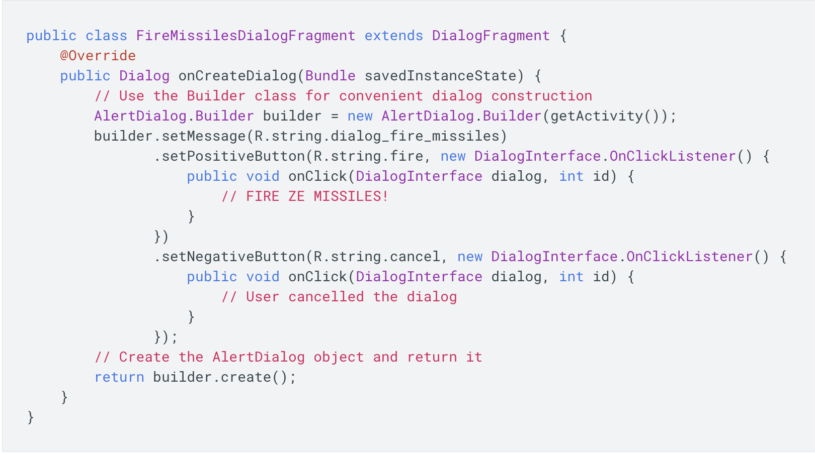
Dialog - Sample Code

Slide 4
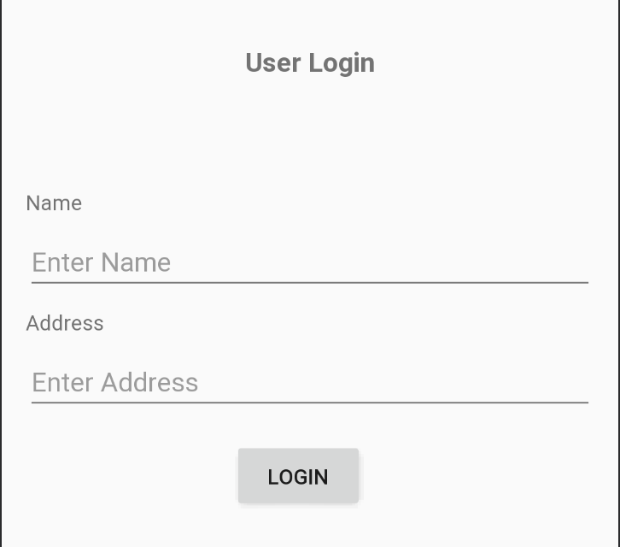
Program

Slide 5
Form Validation
Check if Fields are empty using
TextUtils.isEmpty(“string_value”);
Show error message using
editText.setError(“error message”);

Slide 6
Fonts
A font is a graphical representation of text that may include a different typeface, point size, weight, color, or design.
Fonts available in Android Studio
Casual
Cursive
Monospace
Sans-serif,black, condensed,condensed-light,light,medium, smallcaps, thin
Serif
serif-monospace

Slide 7
Fonts
We can set fonts from
XML
Programatically
styles.xml
XML
android:fontFamily="@font/font_name"
Programatically
Typeface typeface = getResources().getFont(R.font.font_name); textView.setTypeface(typeface);
styles.xml
<style name="your_style_name">
<item name="android:fontFamily">@font/font_name</item>
</style>

Slide 8
Fonts- Set font from XML
In the layout XML file, set the fontFamily attribute to the font file you want to access
<TextView
android:layout_width="wrap_content"
android:layout_height="wrap_content"
android:fontFamily="@font/lobster"/>

Slide 9
Fonts - Set font from styles.xml
<TextView
style="@style/TextStyle"
android:id="@+id/tv_name"
android:layout_width="wrap_content"
android:layout_height="wrap_content"
/>

Slide 10
Sample Question
What do you understand by dialog box in android? [5]
How can we apply fonts to views ? [5]

